Slide 1
Suggested talks
Shuki Ronen
Adjunct Professor
2026 SEP Affiliate meeting

Slide 2
Content
http://www.totumgeo.com/Stanford/BodegaBay/Aberdeen.pdf
  To be presented June 10 at the EAGE Annual meeting in Aberdeen
  Practice talk at the SEP affiliate meeting
http://www.totumgeo.com/Stanford/BodegaBay/Rio.pdf
  Will have been presented at the EAGE-SBGf Equatorial Margins workshop in Rio the week before the SEP meeting

Slide 3
1. Aberdeen Talk—title and abstract
The effect of the reflection from the seabed on source signature recorded by ocean bottom nodes
We use near field hydrophones (NFH) to record source signatures
Surface towed streamers do not offer a good alternative to NFH
Ocean Bottom Nodes have far field hydrophones
We learned that we must take the seabed reflection into account

Slide 4
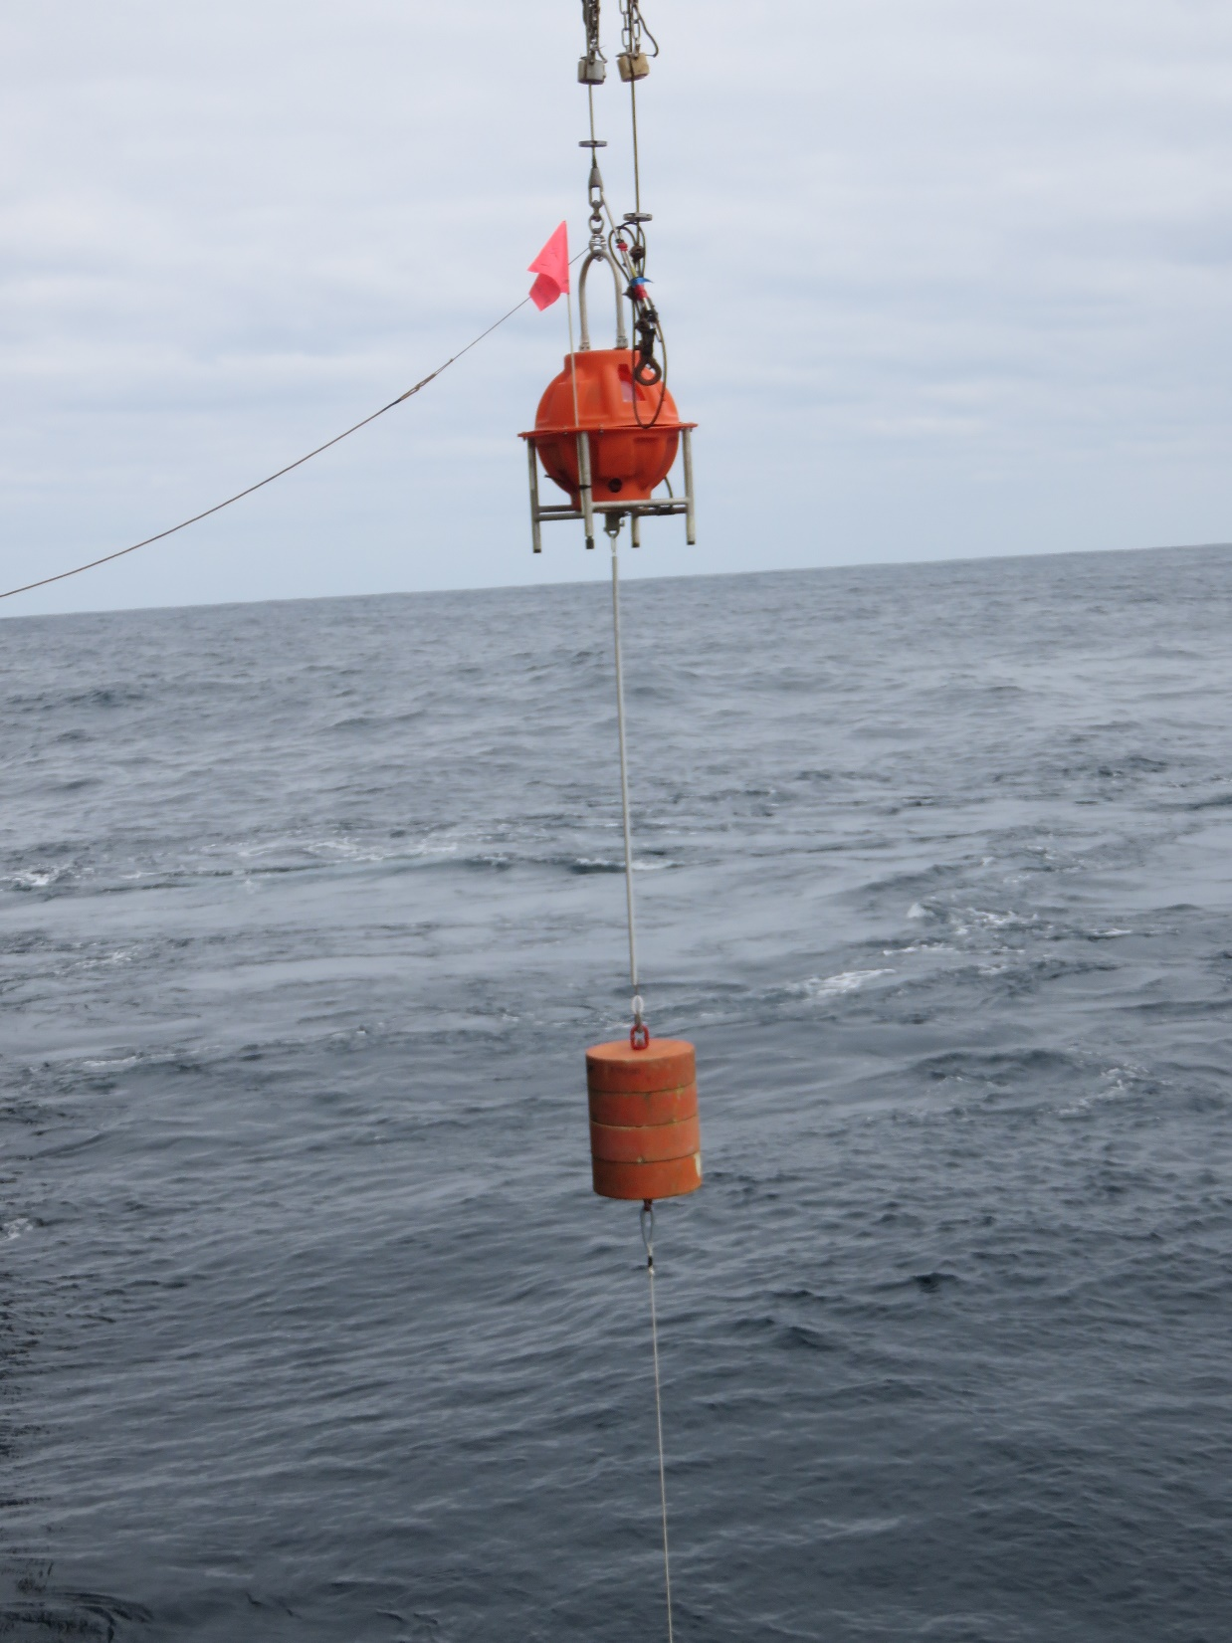
1. Aberdeen Talk
We deployed two OBN in an area of test shooting
One node on the seabed
Another one 100m above the seabed

Slide 5
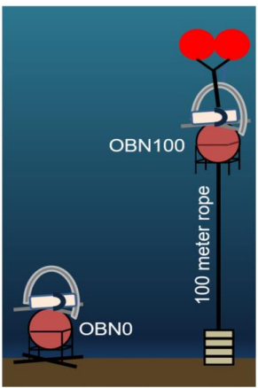
1. Aberdeen Talk
We deployed two OBN in an area of test shooting
One node on the seabed
Another one 100m above the seabed

Slide 6
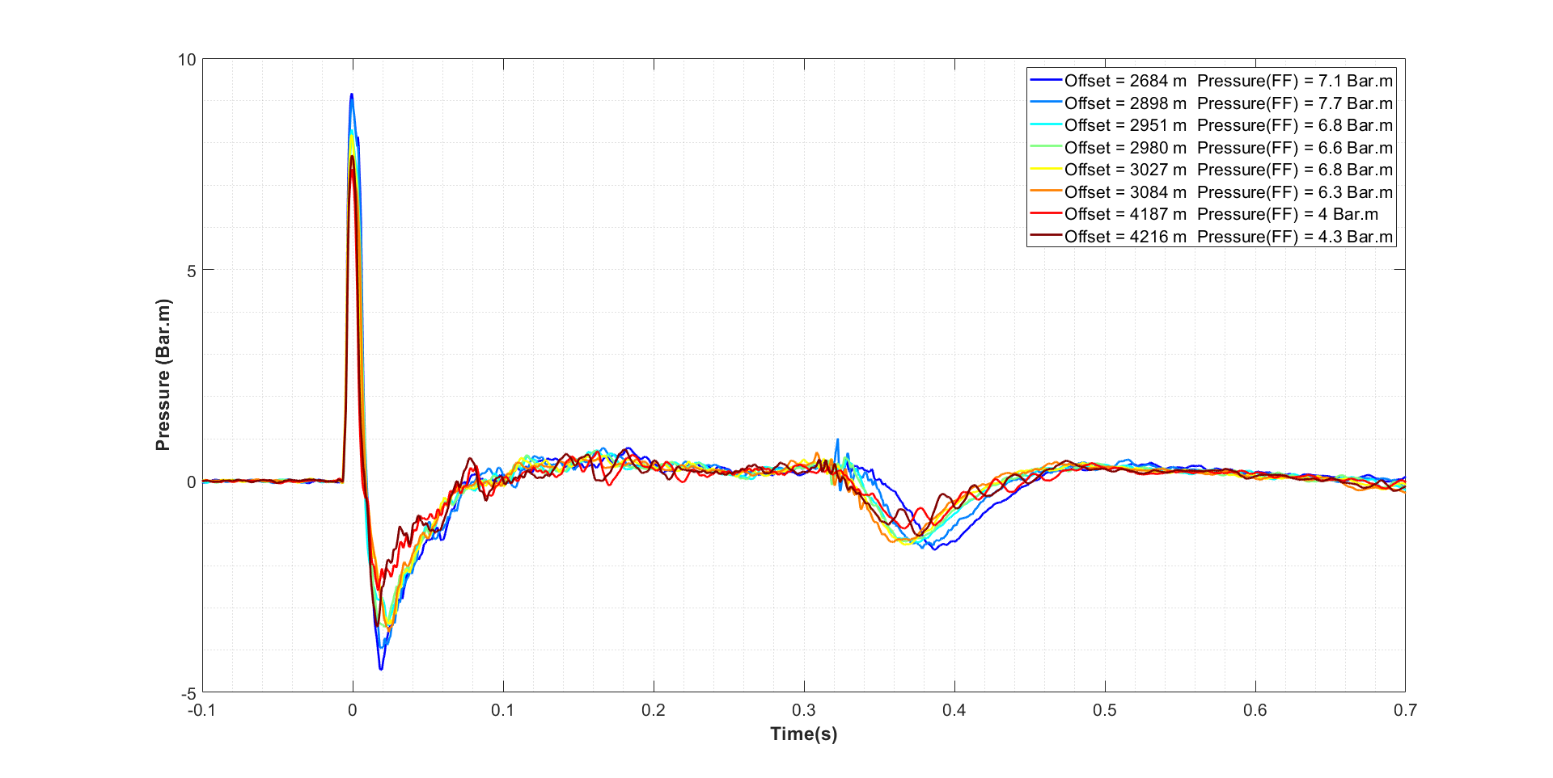
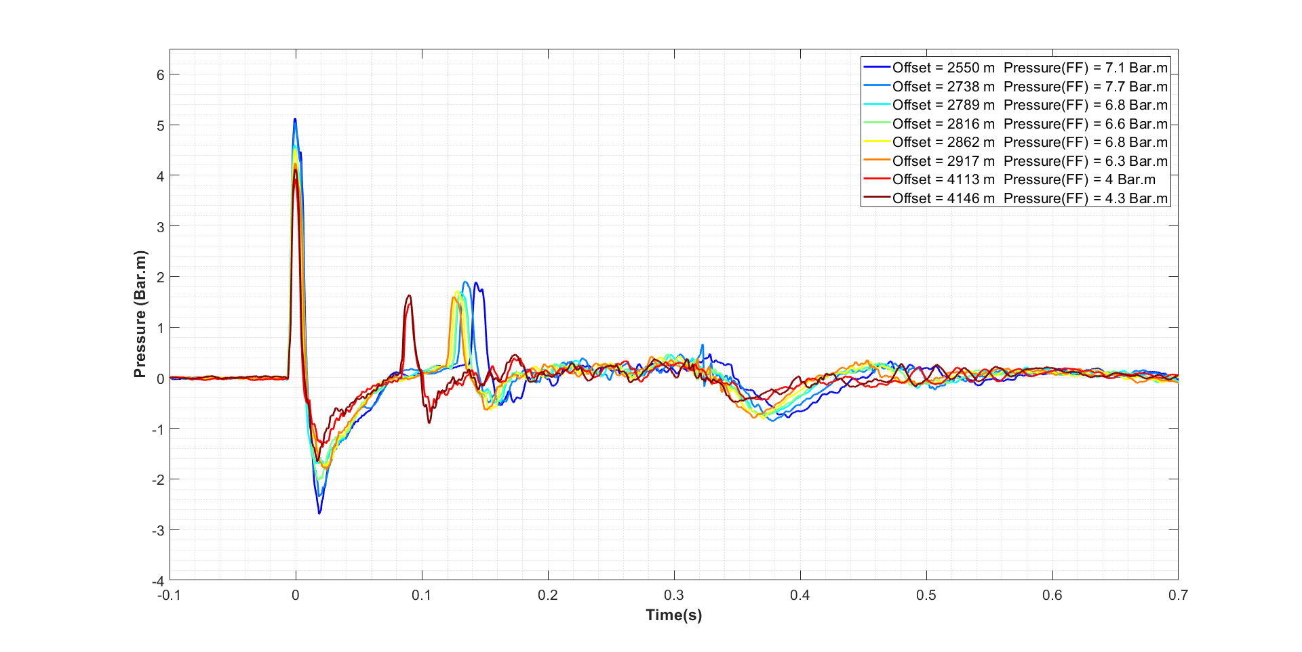
1. Aberdeen Talk—Raw data
← All shots, when scaled by offset come out at about 9 Bar-Meters
Node on the seabed
Node hung 100 meters above the seabed
← Only about 5 Bar-Meters here
← This is the reflection from the seabed
Nearer offset (dark blue) longer delay

Slide 7
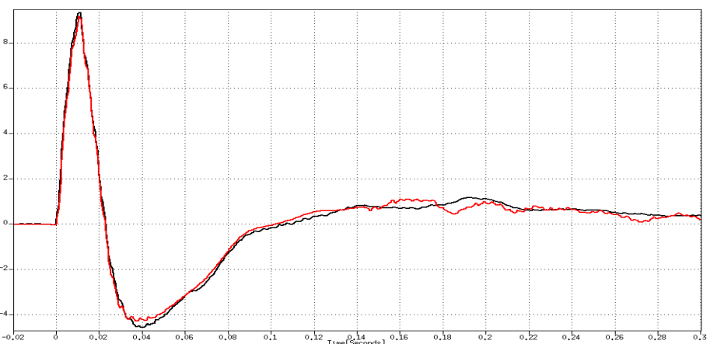
1. Aberdeen Talk—Cooked data
Deghosting
Source ghost
  Water-air surface
Receiver ghost
  Seabed
— Node on the seabed
— Node hung 100 meters above the seabed

Slide 8
1. Aberdeen Talk—why is it important?
Who cares how many Bar-M a source is?
Environmental impact assessment (permitting)
Feasibility studies, Survey Design: Signal / Noise ratio
Data processing: “PZ combination: Up / Down separation”
The seabed ghost in negative for hydrophone
It is positive for geophones (and accelerometers)
Up and Down, and Above and Below

Slide 9
2. Rio Talk—two case histories
Low Frequency Sources: mission critical for pre-salt and sub-basalt and added value with neither salt nor basalt
Basalt (WoS)
Salt (GoM)

Slide 10
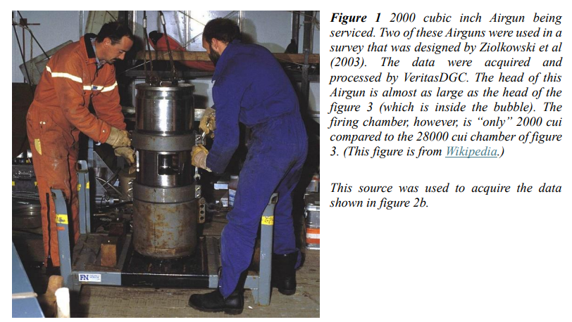
2. Rio Talk—WoS source

Slide 11
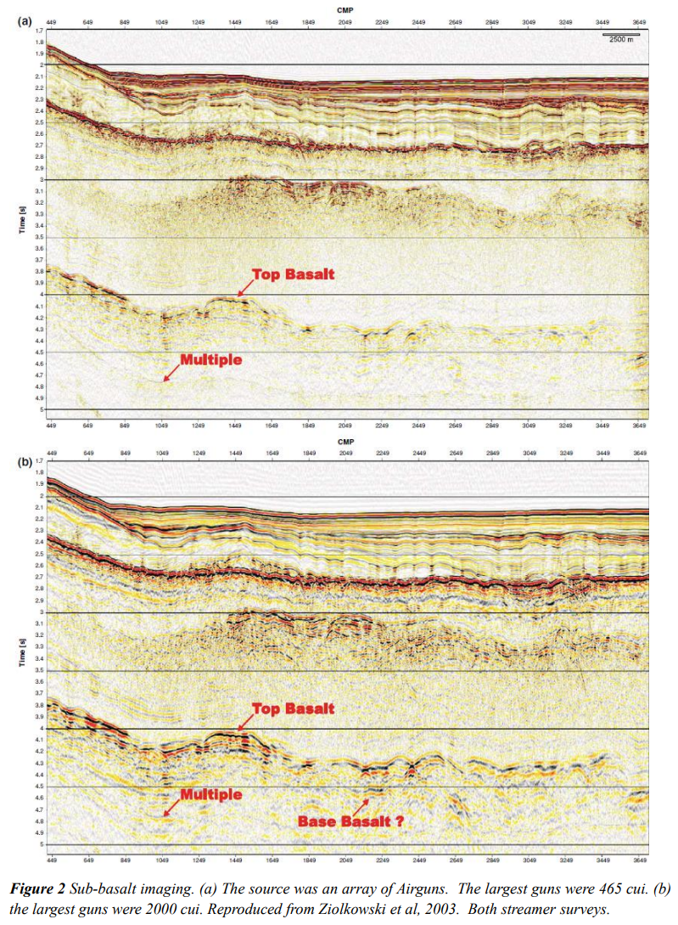
2. Rio Talk—Conventional Airguns (WoS)
IMAGE 2024
Merritt et al

Slide 12
2. Rio Talk—Low frequency source (WoS)

Slide 13
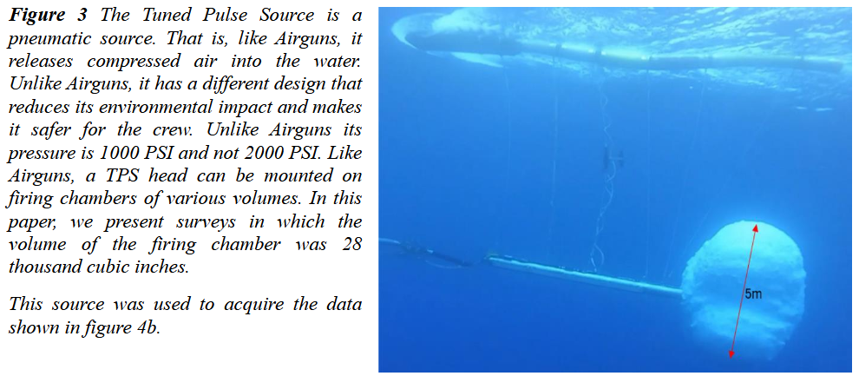
2. Rio Talk—GoM source

Slide 14
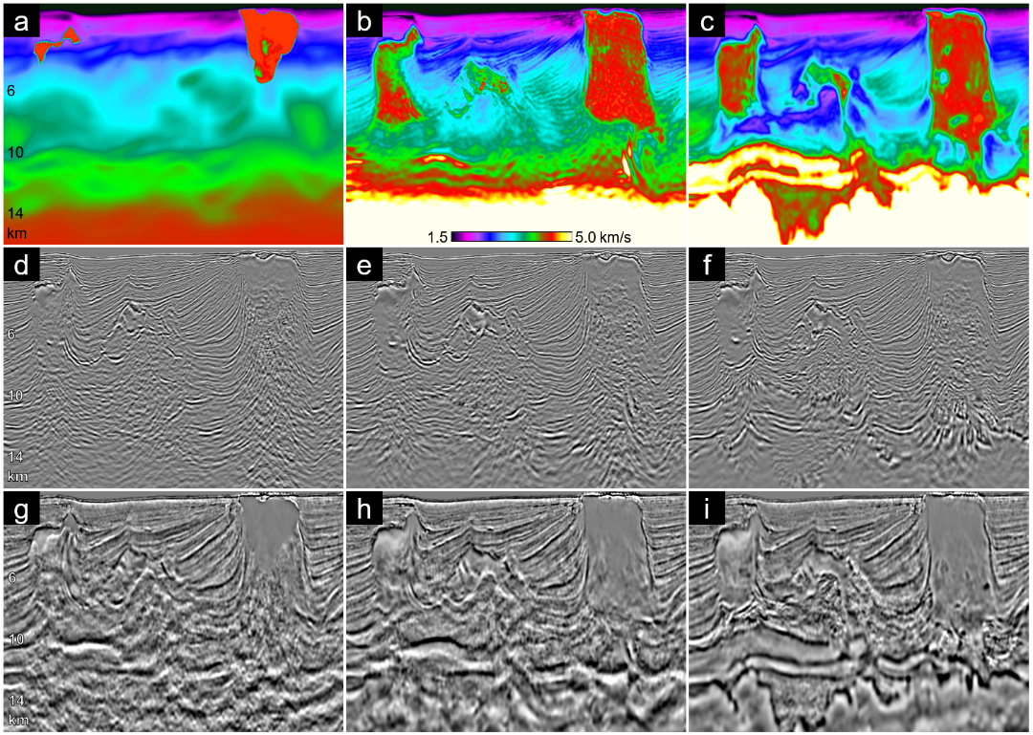
2. Rio Talk—Reflectivity (GoM)
IMAGE 2024
Merritt et al
Full Azimuth Streamers
Airguns, 15 Hz RTM
Ocean Bottom Nodes
Tuned Pulse Source, 5 Hz FWI
Both data sets were imaged by the same RTM method (except max frequency)

Slide 15
2. Rio Talk—Velocity (GoM)
Full Azimuth Streamers with Airguns
Ocean Bottom Nodes with TPS
(2)
(2)
(2)
(1)
15km
Note: (1) 15 km deep imaging
(2) post salt improved blocky earth model
Both processed by the same TL-FWI method

Slide 16
2. Rio Talk—Summary
Low Frequency Sources
Mission critical for pre-salt and sub-basalt
Added value with neither salt nor basalt
(2)

